Slide 1
AI-Powered One-Up Puzzle Solver
Course Number: DSCI6051-02
Team 05

Slide 2
Project Details:
Project Title: AI-Powered One-Up Puzzle Solver
Project Advisor: Mohamad Nassar
MSDS Capstone – FA 24 DSCI 6051-02
Final Report

Slide 3



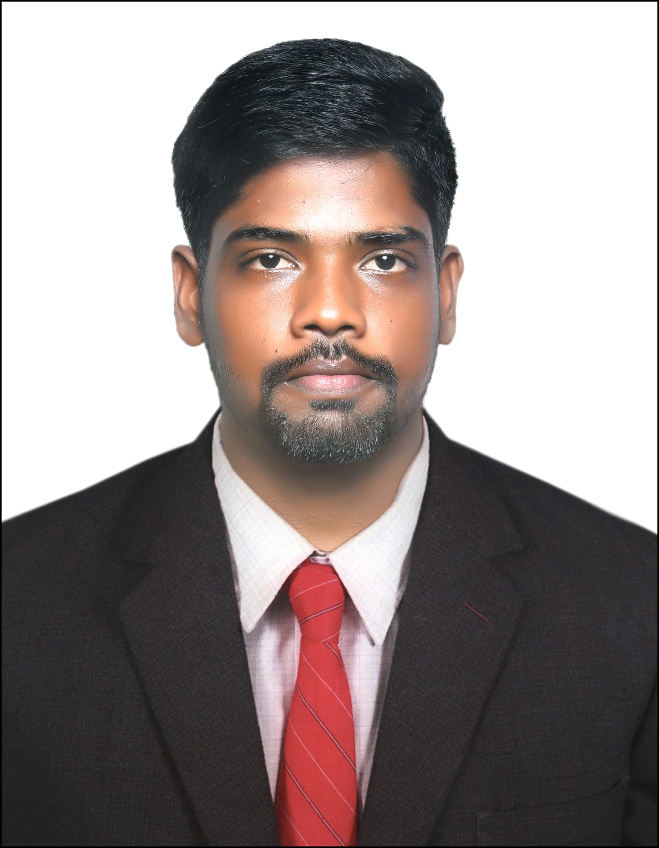
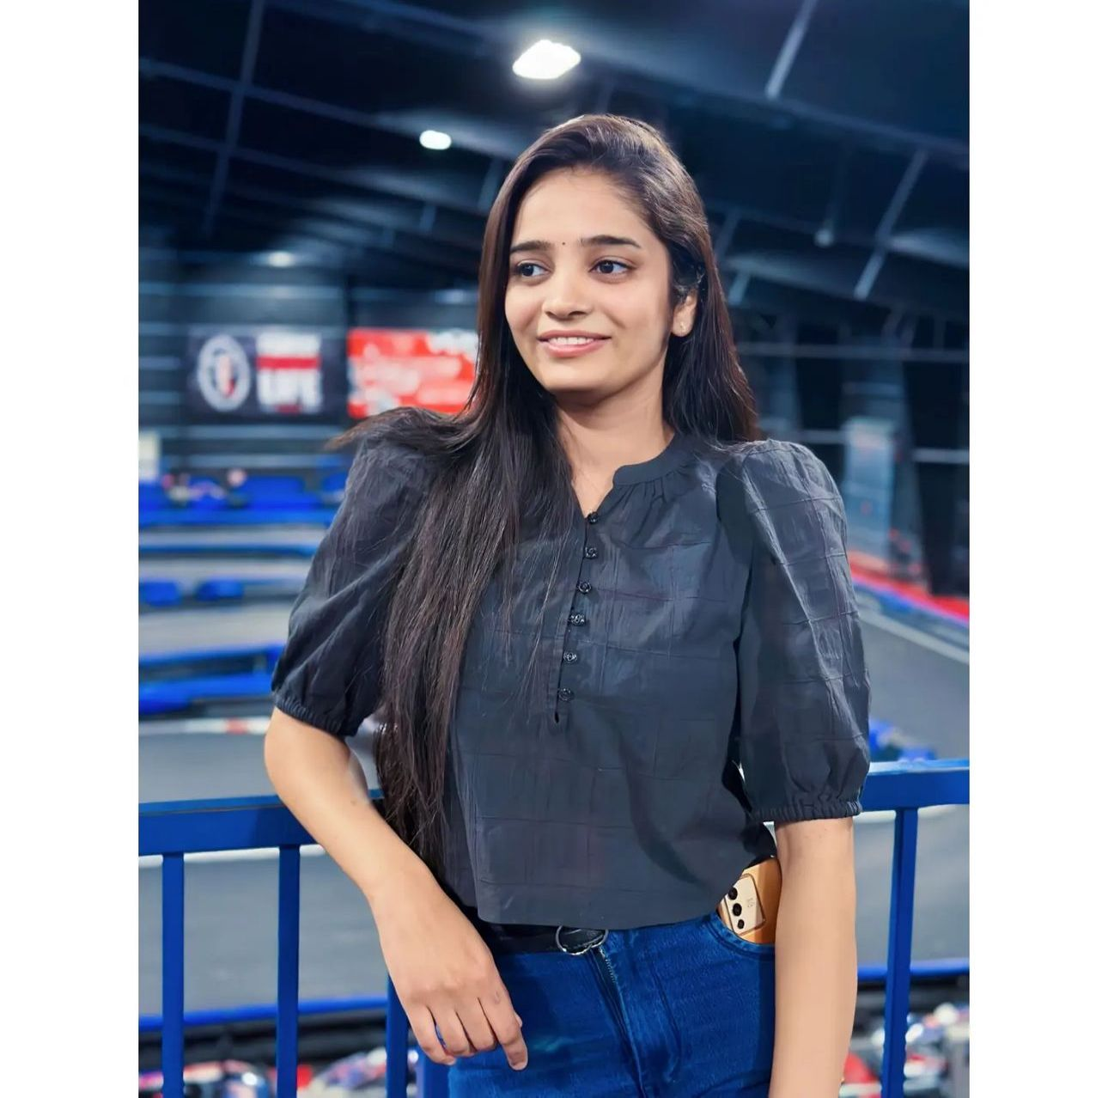
Dharanidhar Manne
Ravi Prasad Grandhi
Jitendra Kadiyam
Chola Yaswanth Kumar Golla
Sravya Kaitha

Slide 4

AI-Powered One-Up Puzzle Solver
INTRODUCTION & OBJECTIVES
Objective
Developing a computational framework to efficiently solve One up puzzle using backtracking, constraint satisfaction, and visual aids.
Key Problem Statement
The One up Puzzle involves solving a segmented grid with numerical constraints, walls, and blocks. Efficient grid parsing and visualization are key to the algorithm's success.
Scope
Solve various One up Puzzle samples (n*n grids) using computational algorithms.
Convert encoded grid data into numerical formats for algorithmic processing.
Develop visualization techniques to render the grid and its solution for enhanced understanding.

Slide 5
Business Understanding
Business Objectives
The project aims to automate One up Puzzle solving for educational, recreational, and commercial use, offering efficient solutions with engaging visualizations. It also plans to integrate automated image processing for wider accessibility.
Success Criteria
Business success: Accurate One up Puzzle solving and clear visualization of solutions.
Technical success: Efficient grid parsing, accurate representation, and implementation of backtracking/constraint satisfaction.

Slide 6



Planning
The project utilized the following tools and technologies:
Programming Language: Python for algorithm implementation and visualization.
Libraries: Matplotlib for visualization and NumPy for numerical operations.
Algorithmic Framework: Backtracking and forward propagation for solving constraints.
Initial plans included collecting diverse puzzle samples, encoding grids, implementing a solving algorithm, and rendering visual outputs.

Slide 7
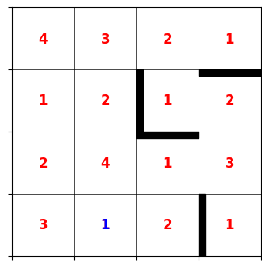
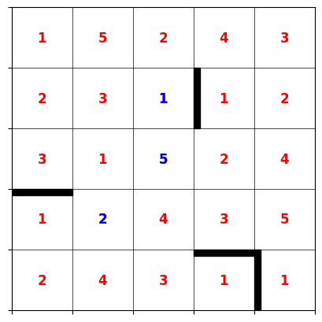
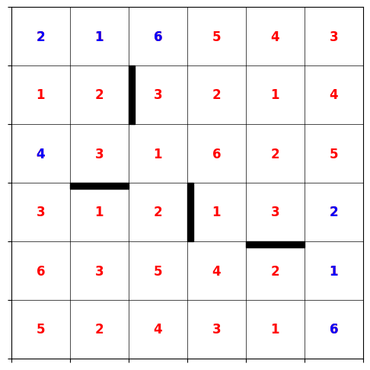
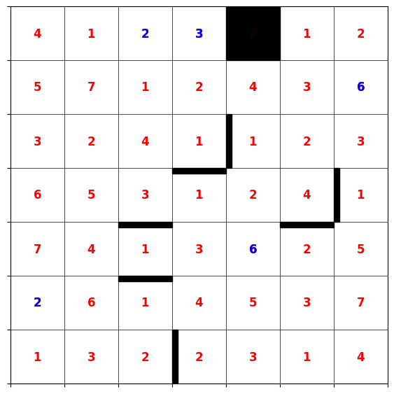
Data Understanding
Data Sources
The project utilized puzzle samples collected manually from the official One up Puzzle website. These samples included grids of various dimensions (4×4, 5×5, 6×6, and 7×7), encoded into string representations ("gamestr_h" and "gamestr_v") for horizontal and vertical features
4×4 5×5 6×6 7×7

Slide 8
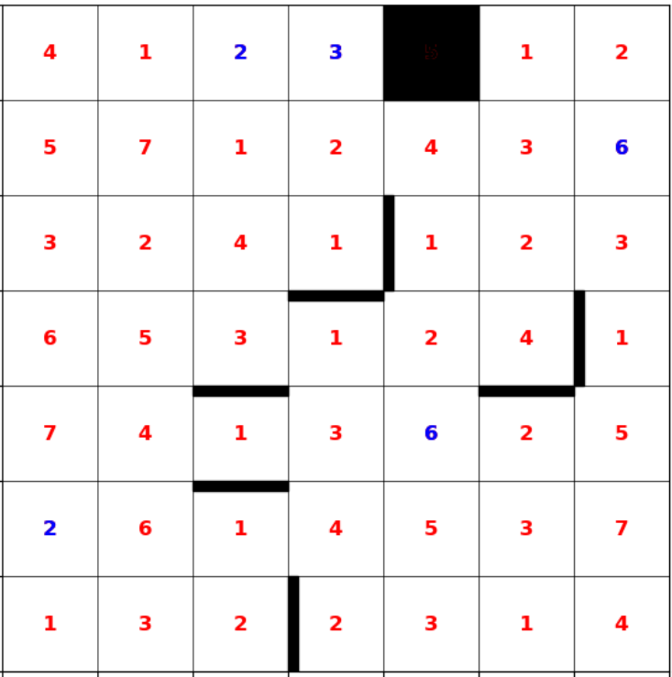
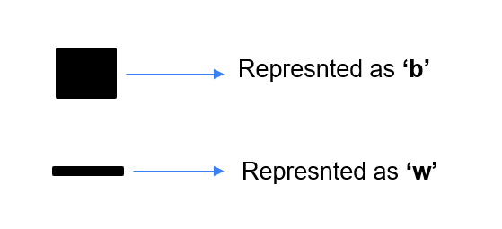
Data Analysis
Parsing and analyzing encoded strings to extract grid structures.
Identified segments defined by walls (‘w’) and blocks (‘b’) splitting the grid into sub-regions.
Observed variation in constraints based on grid size and encoded elements, affecting domain definitions.
Challenges included ensuring accurate string parsing and adapting the algorithm to diverse grid configurations.
Data Quality Issues
No missing data was found, but manual collection led to potential inconsistency in string formatting. Ensuring uniform encoding standards across all samples was crucial for algorithm compatibility.

Slide 9
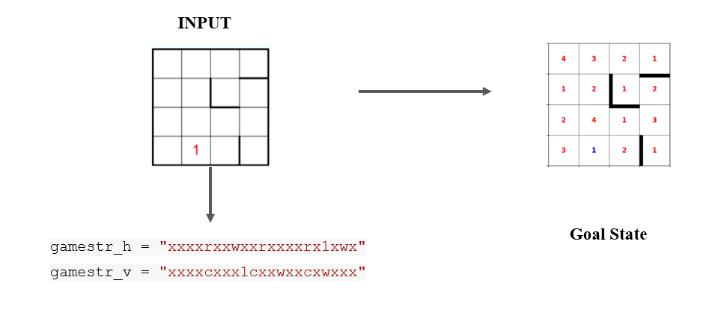
Data Cleaning: ensuring proper formatting of "gamestr_h" and "gamestr_v," with matching rows and columns and valid symbols (‘w’, ‘b’, ’x’, numerical values).
Integration: The parsed horizontal and vertical strings extracted grid details like walls, blocks, and cell values, which were then structured into a numerical dataset.
Formatting: using "merge_segments" for consistent representation, and valid numerical domains for each cell were computed for constraint analysis.

Slide 10
Challenges & Key Deliverables
Challenges
Manual Data Collection: Ensuring the consistency of manually encoded strings required thorough validation to prevent parsing errors.
Diverse Grid Sizes: Adapting the parsing logic to handle varying grid sizes and complexities, including wall and block segmentations, was challenging. This was addressed by refining the "merge_segments" and "segment_analysis" functions.
Key Deliverables
A structured dataset representing grid cells, including their domains, walls, and block placements.
Encoded numerical representations for various grid sizes, ready for algorithmic processing.
Validation mechanisms to ensure the dataset's consistency and accuracy.

Slide 11
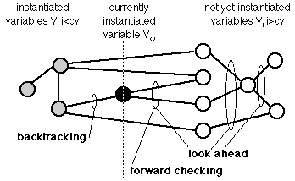
Modelling
Models Built
A backtracking algorithm with forward propagation was used to solve the “One up Puzzle”.These techniques were chosen for their effectiveness in constraint satisfaction problems and their ability to handle the grid's complexities.
Training Process
The algorithm was refined iteratively using sample grids, employing heuristic-based cell selection and recursive exploration.

Slide 12
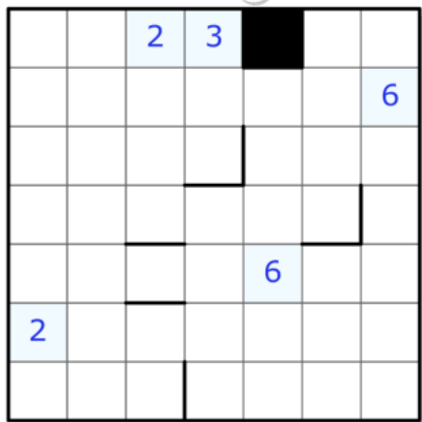
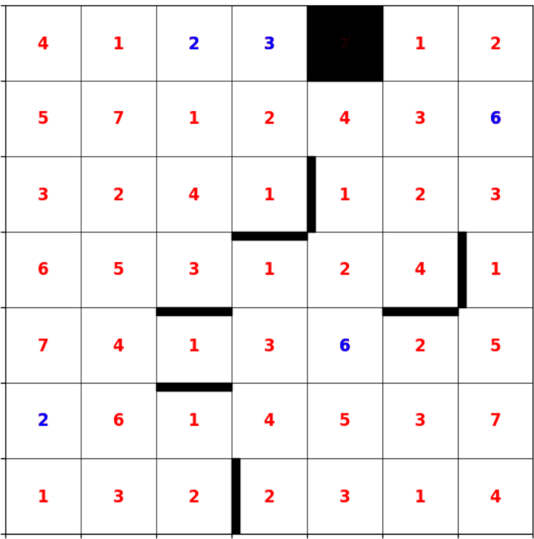
Evaluation
Model Results
The backtracking algorithm accurately solved all One up Puzzle samples with high accuracy, and the visualization effectively displayed solutions and grid constraints, fulfilling the project's objectives.
Key Learnings
Efficiency Gains: Forward propagation significantly reduced computational overhead, particularly for larger grids.
Complexity Handling: The algorithm effectively handled puzzles with varying segmentations and constraints, with smaller, complex grids posing more challenges than larger, open grids.
Input State Output State

Slide 13
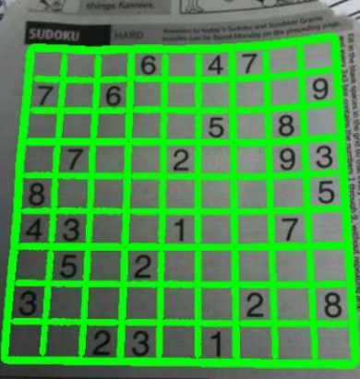

Next Steps
Future improvements include integrating OpenCV and OCR for automatic image-to-string conversion, enhancing accessibility.
Exploring advanced heuristics or parallel processing could optimize performance for larger or more complex puzzles.
Grid extraction Parallel Processing
(using openCV)

Slide 14
What We Learned
New Tools & Technologies
Backtracking Algorithm: Gained a deeper understanding of how backtracking, combined with forward propagation, efficiently solves constraint-based puzzles like the Oneupuzzle.
Visualization Tools: Enhanced proficiency in using Python libraries such as Matplotlib and NumPy for rendering puzzle grids and their solutions.
Encoding and Parsing Techniques: Learned to convert string-based puzzle representations into numerical formats for computational processing.
Team Growth
Algorithmic Thinking: Developed skills in breaking down complex problems into manageable segments and solving them using systematic computational approaches.
Collaboration: Improved teamwork by dividing tasks such as data collection, algorithm development, and visualization, ensuring smooth integration of components.
Adaptability: Strengthened problem-solving capabilities by overcoming challenges in grid parsing and optimizing the algorithm for diverse grid sizes and constraints.

Slide 15
Future Recommendations
Enhancements
Automated Data Input: Use OpenCV and OCR to convert grid images into strings, reducing manual efforts.
Performance Optimization: Apply advanced heuristics and parallel computing for faster solving.
Dynamic Visualization: Create interactive tools for step-by-step solving insights.
Long-Term Applications
Game Solvers: Adapt the framework for puzzles like Sudoku or Kakuro.
Mobile Integration: Develop a mobile app for real-time puzzle solving via image uploads.
Next Steps
Focus on robust testing with varied grids and edge cases.
Explore reinforcement learning for improved solving efficiency.
Provide user-friendly documentation and tutorials for wider project adoption.

Slide 16

Any Questions ?

Slide 17


